Slide 1
Linear Regression
Elsayed Hemayed
The original slides are from EMC Data Analytics Course and from Udmey course by SuperDataScience Team

Slide 2
Overview of Linear Regression
General description of regression models
Technical description
Handling Categorical Values
Building A Model
Diagnostics for validating the linear regression model
Overfitting Problem and Regularization
The Reasons to Choose (+) and Cautions (-) of the linear regression model

Slide 3
Regression
Regression focuses on the relationship between an outcome and its input variables.
In other words, we don't just predict the outcome, we also have a sense of how changes in individual drivers affect the outcome.
Examples:
Income as a function of years of education, age, gender
House price as function of median home price in neighborhood, square footage, number of bedrooms/bathrooms
Neighborhood house sales in the past year based on unemployment, stock price etc.
Notes:
The term "regression" was coined by Francis Galton in the nineteenth century to describe a biological phenomenon. The phenomenon was that the heights of descendants of tall ancestors tend to regress down towards a normal average (a phenomenon also known as regression toward the mean).
Specifically, regression analysis helps one understand how the value of the dependent variable (also referred to as outcome) changes when any one of the independent variables changes (also referred as drivers), while the other independent variables are held fixed. Regression analysis estimates the conditional expectation of the dependent variable given the independent variables — that is, the mean value of the dependent variable when the independent variables are held fixed.
Some example questions are :
I want to predict the lifetime value of this customer and understand what drives LTV. What drives the LTV higher or lower?
I want to predict the probability that this loan will default and understand what drives default
Regression focuses on the relationship between the outputs and the inputs. It also provides a model that has some explanatory value, in addition to predicting outcomes. Social scientists used regression mainly for its explanatory value and it can be a fairly good predictor for which method is popular among Data Scientists.
The outcome can be continuous or discrete and when it is discrete we are predicting the probability that the outcome will occur.
Two types of regression methods will be discussed in this module. This lesson will focus on the Linear regression and the next lesson will detail Logistic regression.

Slide 4
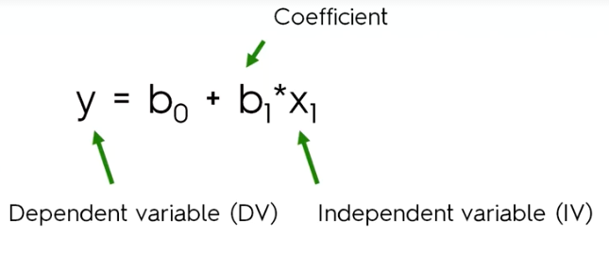
Simple Linear Regression

Slide 5
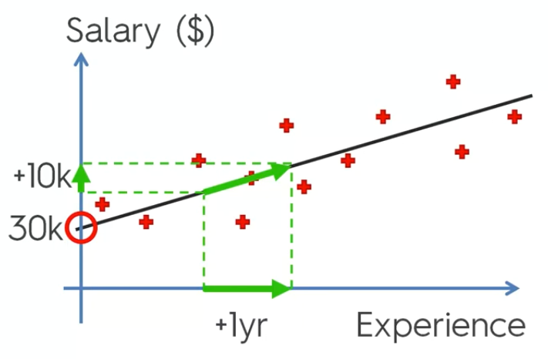
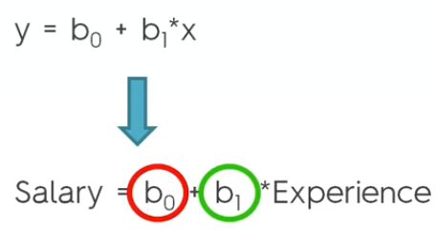
Simple Linear Regression

Slide 6
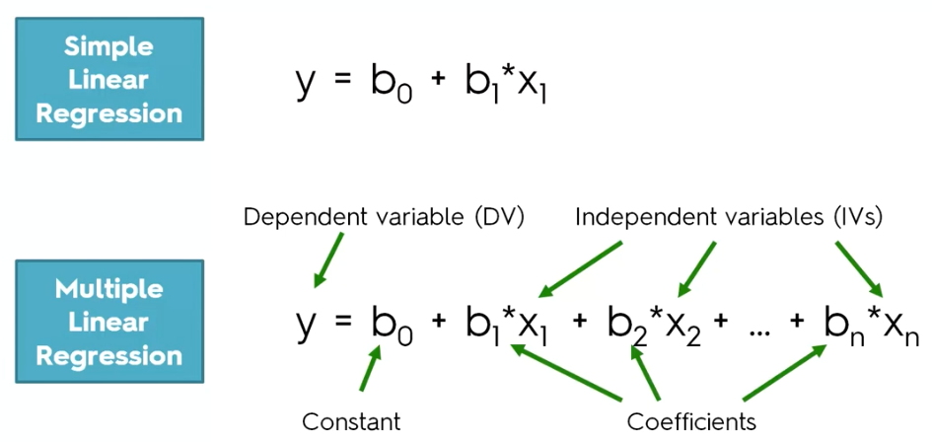
Linear Regression

Slide 7
Linear Regression
Used to estimate a continuous value as a linear (additive) function of other variables
The preferred method for almost any problem where we are predicting a continuous outcome
Try this first; if it fails, then try something more complicated
Notes:
We use Linear regression to predict a continuous value as a linear or additive function of other variables. Some examples are
Predicting income as a function of number of years of education, age and gender (drivers).
House price (outcome) as a function of median home price in the neighborhood, square footage, number of rooms.
Neighborhood house sales in the past year based on economic indicators.
The input variables can be continuous or discrete and the outputs are:
A set of coefficients that indicate the relative impact of each driver (possibly and how strongly the variables are correlated)
A linear expression predicting the outcome as a function of drivers.
Linear Regression is the most frequently used technique for predicting a continuous outcome. It is simple and works well in most instances. It is recommended that Linear regression should be tried and if it is determined that the results are not reliable other complicated models should be used.

Slide 8
Technical Description
Solve for the bi
Ordinary Least Squares
Categorical variables are expanded to a set of indicator variables, one for each possible value.
Notes:
Linear regressions are of the form y is equal to a constant term + a linear combination of all the variables. The linear combinations are made up of a coefficient term “b_{i}” multiplied by the value of the corresponding variable.
The problem itself is solving for the b_{i}
It is a matrix inversion problem and the method is referred to as Ordinary Least Squares (OLS). The solution requires storage as the square of the number of variables and we need to invert a matrix. The complexity of the solution (both in storage and computation) increases as the number of variables increase.
When you have categorical variables, they are expanded as a set of indicator variables one for each possible value. We will explain this in the next slide in more detail with an example.
What we highlight here is that if we expand on categorical variables (ZIP codes as a categorical value) we will end up with lot of variables and the complexity of the solution becomes extremely high.

Slide 9
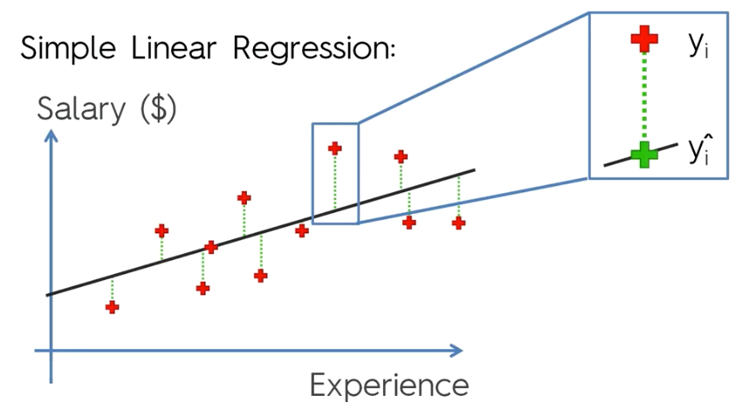
Ordinary Least Squares
OLS: Minimize Sum(y_{i}-y_{i}^)²

Slide 10
Representing Categorical Variable
State is a categorical variable: 50 possible values.
Expand it to 49 indicator (0/1) variables:
The remaining level is the "default level“
This is done automatically by standard packages
Gender is categorical, too, but binary
so one variable: genderMale, which is 0 for females
Notes:
Here we present another example:
We are predicting income given age, years of education, gender and state. There are 50 possible values for state and we will have to expand it to 49 indicator variables with 0 or 1 and the remaining level is the default level.
As Gender is a binary variable it is denoted as a single variable genderMale, which is 0 for females.
Usually, you want to solve for log income, but just discussing income makes the explanations easier. The implicit assumption with linear regression is that the variables are normally distributed. In reality “income” is not normally distributed. So it is a good practice to model for the log of the income.

Slide 11
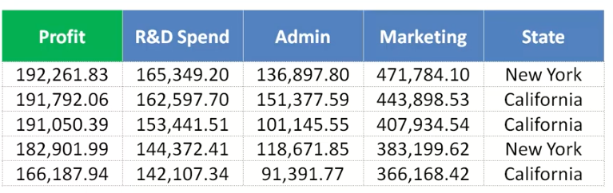
Regression Example

Slide 12
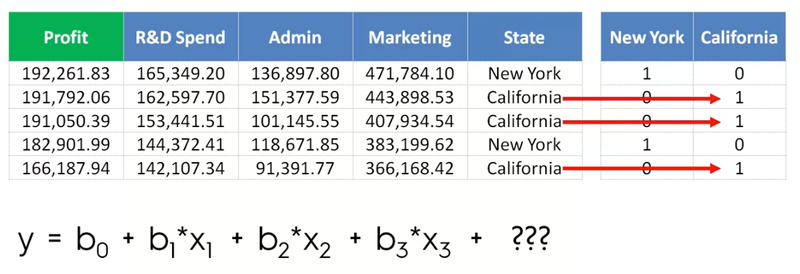
Dummy Variables

Slide 13
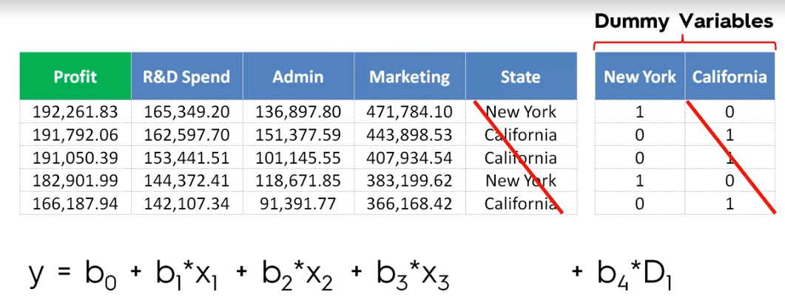
Dummy Variables

Slide 14
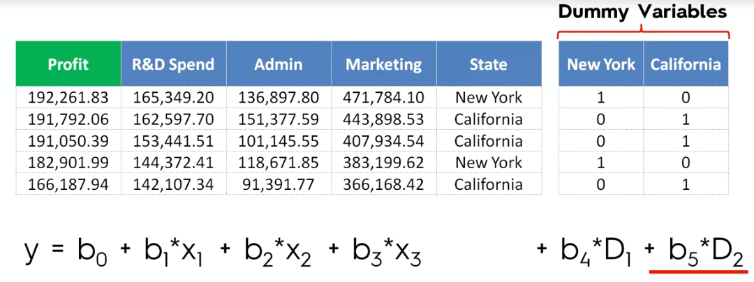
Dummy Variable Trap
X

Slide 15
Continuous Vs. Categorical Variables
General linear regression model:
Independent variables (X’s):
Continuous: age, income, height → use numerical value
Categorical: gender, city → use dummies.
Dependent variable (y):
Continuous: consumption, time spent → use numerical values
Categorical: yes/no → use dummies.

Slide 16
What do the Coefficients b_{i} Mean?
Change in y as a function of unit change in x_{i}
all other things being equal
Example: income in units of $10K, years in age, b_{age}= 2
For the same gender, years of education, and state of residence, a person's income increases by 2 units (20K)for every year older
Standard packages also report the significance of the b_{i}: probability that, in reality, b_{i} = 0
b_{i} "significant" if P(b_{i} = 0) is small
Notes:
The first coefficient, b₀, represents the value of the outcome in the "reference situation" – the situation that is represented by all the continuous variables set to zero, and the categorical variables at their reference.
For the example on the previous slide, if the reference value of state is Alabama, and the reference value of gender is Female, then b₀ would represent the income of a hypothetical female from Alabama, who is zero years old, with zero years of education. Obviously, this situation doesn't always make sense, but it does give us a reference point from which the income varies, as we change the values of the different drivers.
The coefficients b_{i} measure the change in outcome variable as a function of unit change in the input variable considering all other things being equal.
Consider our example in the previous slide. Let us say income in units of 10K and the coefficient b_{age}= 2 for years in age. If the other variables such as gender, years of education, and state of residence remain the same, a person’s income increases 20K for every year older.
If the coefficient for b_{stateNebraska} is 2.3, then a 30 year old male with 16 years of education tends to make 2.3 times higher income in Nebraska, than in Alabama.
In R (and in many other packages), the reference level of categorical variables is the level that comes first alphabetically. You can set the reference level explicitly, by using the relevel() command.
In Linear regression we said earlier that the coefficients are explanatory and not just predictive. So we want to know if the variable really makes a difference. For example if we ask the question “does age impact income?” and we conclude the answer is no, then the coefficient for age must be zero.
We use the measure of significance for this purpose. Standard packages report the significance of b_{i.}
The significance is the probability that b_{i} is zero. Or b_{i} “ is significant" if P(b_{i} = 0) is small.

Slide 17
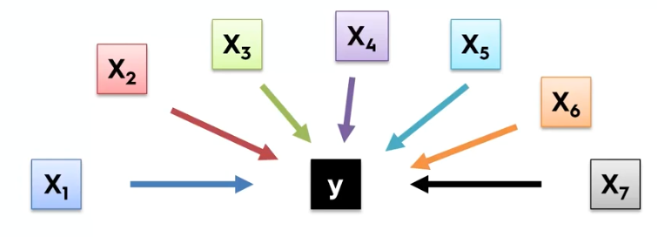
Building A Model
Which X to use?

Slide 18


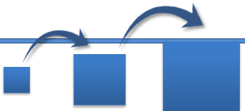
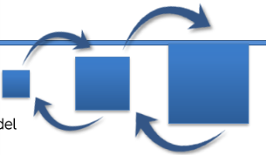

Building A Model
All-in
Backward Elimination
Forward Selection Stepwise Regression
Bidirectional Elimination
Score Comparison

Slide 19
Backward Elimination
Select a significance level to stay in the model (e.g., SL=0.05)
Fit the full model with all possible predictors
Consider the predictor with the highest p-value. If p>SL then go to step 4, otherwise goto step 5
remove the selected predictor, and fit model without it.
5. The model is ready

Slide 20
Forward Selection
Select a significance level to enter the model (e.g., SL=0.05)
Fit the full model with all possible predictors, select the one with the lowest p-value
Keep this variable and fit all possible model with one extra predictor added to the one(s) you already have.
Consider the predictor with the lowest p-value. If p<SL, go to step 3 otherwise go to step 5.
5. The model is ready

Slide 21

Bidirectional Elimination
Select a significance level to enter and to stay in the model (e.g., SLENTER=0.05, SLSTAY=0.05).
Preform the next step of Forward Selection (new Variables must have p<SLENTER to enter)
Perform all steps of Backward Elimination (old variables must have P<SSLSTAY to stay)
Repeat step 2 and 3 till no new variables can enter and no new variables can exit. Then the model is ready.

Slide 22

All Possible Models
Select a criteria of goodness of fit
Construct all possible regression models (2^N -1 total combinations for N predictors)
Select the one with the best criterion

Slide 23
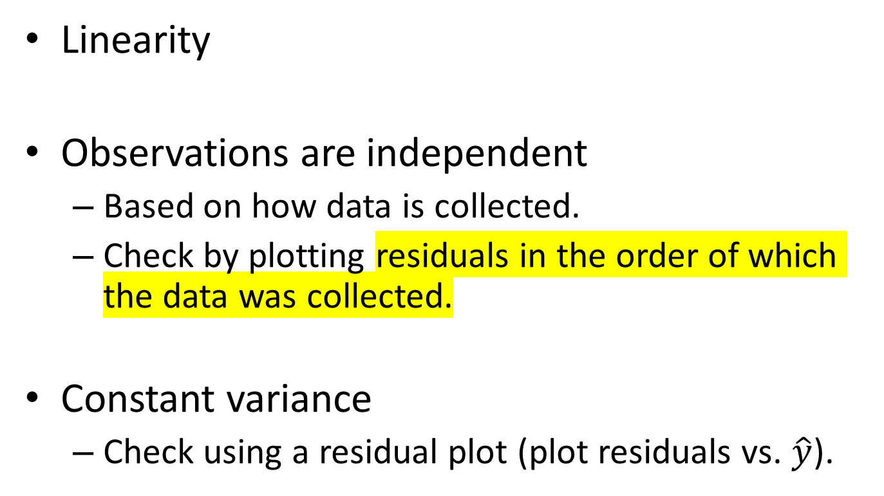
Simple Linear Regression Assumptions
Linearity
Observations are independent
Based on how data is collected.
Check by plotting residuals in the order of which the data was collected.
Constant variance
Check using a residual plot (plot residuals vs. $\hat{y}$).
Notes:
Constant Variance (Homoscedasticity):
In a residual plot, constant variance is assessed by examining whether the spread or dispersion of residuals remains relatively consistent across the range of the independent variable(s) or the predicted values.
If the spread of residuals is relatively constant and does not exhibit a systematic pattern (e.g., widening or narrowing as the values of the independent variable(s) change), then the assumption of constant variance is met, indicating homoscedasticity.
Model Fit (Linearity):
Residual plots also help assess the linearity assumption, which states that the relationship between the independent variable(s) and the dependent variable is linear.
In a residual plot, the linearity assumption is evaluated by examining whether the residuals are randomly scattered around the horizontal axis. If the residuals exhibit a random scatter with no discernible pattern, it suggests that the linear model adequately captures the relationship between the variables.
Patterns or non-randomness in the residual plot (e.g., curvature, clusters, or systematic deviations from the horizontal axis) indicate potential issues with the linearity assumption. For example, if residuals form a clear pattern (e.g., a curve), it suggests that the linear model may not adequately represent the true relationship between the variables, indicating a poor fit.
The independence of observations is another important assumption in regression analysis. It means that the residuals (errors) from the regression model should be independent of each other. This assumption ensures that one observation's error does not influence the error of another observation.
While a residual plot may not directly show the independence of observations, it indirectly helps in assessing this assumption by examining whether there are any patterns or correlations in the residuals over time or across observations.
Here's how residual plots can provide insight into the independence of observations:
Random Scatter: In general, a residual plot with random scatter around the horizontal axis suggests that the independence assumption is likely met. However, if you observe any systematic patterns or clusters in the residuals, it might suggest dependencies among the observations.

Slide 24
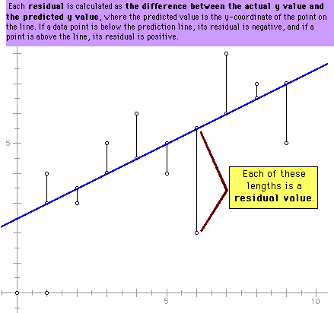
The Residual
y
The residual values provide us some measure of how well the line fits the data, that is, the goodness of fit.
It is calculated as the difference between the actual y value and the predicted y value.
x

Slide 25
Diagnostics: Residual Plot
A residual plot is used to check the assumption of constant variance and to check model fit (is a line a good fit).
Good residual plot: no pattern

Slide 26
Diagnostics
Left: Residuals show non-constant variance.
Right: Residuals show non-linear pattern.

Slide 27
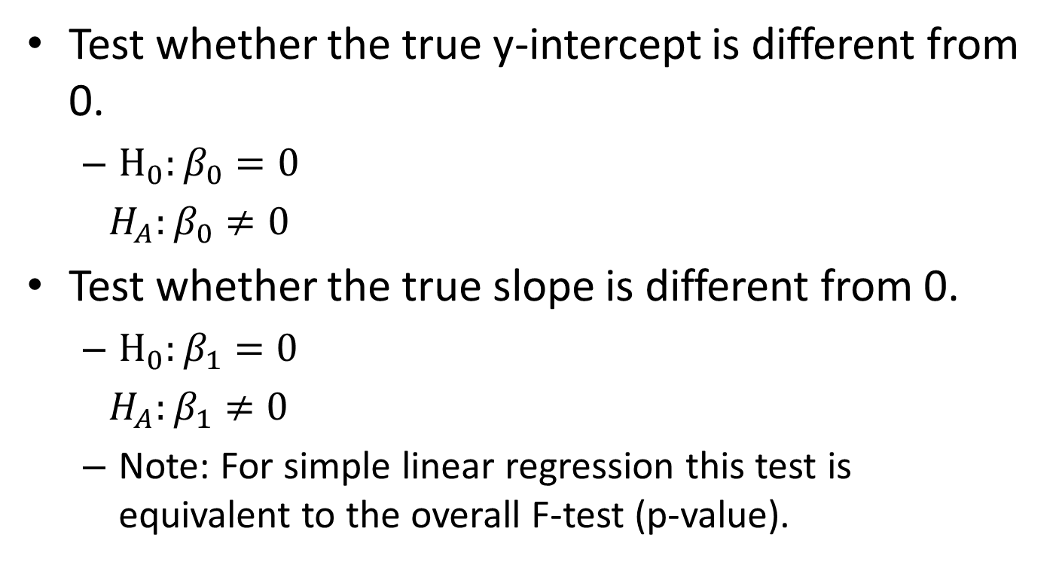
Test for Parameters (F-test)
Test whether the true y-intercept is different from 0.
$H_{0}:β_{0}=0$
$H_{A}:β_{0}≠0$
Test whether the true slope is different from 0.
$H_{0}:β_{1}=0$
$H_{A}:β_{1}≠0$
Note: For simple linear regression this test is equivalent to the overall F-test (p-value).

Slide 28
Linear Regression Example
n <- 100; nosim <- 1000
x1 <- rnorm(n); x2<-rnorm(n);
y <- x1 + rnorm(n, sd = .3)
fit1<-lm(y~x1)
summary(fit1)
plot(x1, fit1$residuals); abline(a=0,b=0,col="red")
#trial
fit2<-lm(y~x2)
plot(x2,fit2$residuals); abline(a=0,b=0,col="red")

Slide 29
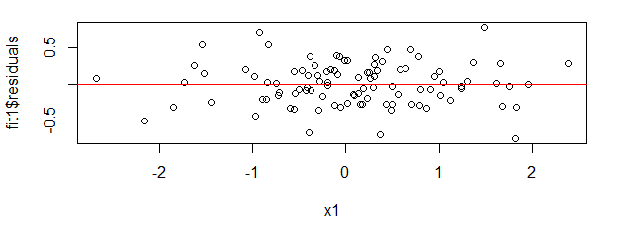
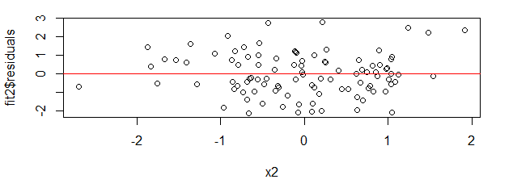
Residual Plots

Slide 30
Model Summary
Residual standard error: 0.275 on 99 degrees of freedom Multiple R-squared: 0.9243, Adjusted R-squared: 0.9235 F-statistic: 1209 on 1 and 99 DF, p-value: < 2.2e-16
Call: lm(formula = y ~ x1)
Residuals: Min 1Q Median 3Q Max
-0.82764 -0.19950 0.03874 0.19408 0.62315
Coefficients: Estimate Std. Error t value Pr(>|t|)
(Intercept) -0.0009003 0.0295453 -0.03 0.976
x1 1.0125675 0.0309821 32.68 <2e-16 ***
--- Signif. codes: 0 ‘***’ 0.001 ‘**’ 0.01 ‘*’ 0.05 ‘.’ 0.1 ‘ ’ 1
Residual standard error: 0.2952 on 98 degrees of freedom
Multiple R-squared: 0.916, Adjusted R-squared: 0.9151
F-statistic: 1068 on 1 and 98 DF, p-value: < 2.2e-16
Try fit1<-lm(y~x1-1)

Slide 31
Multiple Variables General Rules
Omitting variables results in bias in the coefficients of interest unless their regressors are uncorrelated with the omitted ones.
Including variables that we shouldn't have increases standard errors of the regression variables.
The model must tend toward perfect fit as the number of non redundant regressors approaches n (the correct regressors).
R2 increases monotonically as more regressors are included.
The SSE decreases monotonically as more regressors are included.

Slide 32
Multiple Variables Example
n <- 100; nosim <- 1000
x1 <- rnorm(n);
x2 <- rnorm(n);
x3 <- rnorm(n);
y <- x1 + x2+ rnorm(n, sd = .3)
fit1<-lm(y~x1)
fit2<-lm(y~x2)
fit3<-lm(y~x3)
fit12<-lm(y~x1+x2)
fit13<-lm(y~x1+x3)
fit123<-lm(y~x1+x2+x3)
# Data exploration
pairs(y~x1+x2+x3)
# Model Evaluation
summary(fit1)
summary(fit12)
summary(fit123)
anova(fit1,fit12,fit123)

Slide 33
Dependent Variables Example
n <- 100; nosim <- 1000
x1 <- rnorm(n);
x2 <- 2*x1+rnorm(n);
x3 <- rnorm(n);
y <- x1 + x2+ rnorm(n, sd = .3)
fit1<-lm(y~x1)
fit2<-lm(y~x2)
fit3<-lm(y~x3)
fit12<-lm(y~x1+x2)
fit13<-lm(y~x1+x3)
fit123<-lm(y~x1+x2+x3)
# Data exploration
pairs(y~x1+x2+x3)
# Model Evaluation
summary(fit1)
summary(fit12)
summary(fit123)
anova(fit1,fit12,fit123)

Slide 34
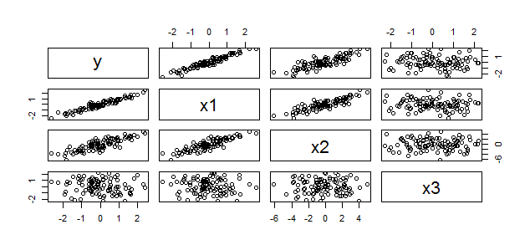
Dependent Variables Example

Slide 35


Diagnostics
Hold-out data
Does the model predict well on data it hasn't seen?
N-fold cross-validation
Partition the data into N groups.
Fit N models, holding out each group, and calculate the residuals on the group.
Estimated prediction error is the average over all the residuals.
R² : The fraction of the variance in the output variable that the model can explain.
It is also the square of the correlation between the true output and the predicted output. You want it close to 1.
Notes:
Creating a hold-out data set (we discussed this in Apriori diagnostics earlier in lesson 2 of this module) before you fit the model, and using that to estimate prediction error is by far the easiest thing to do.
There are two kinds of errors in predictive models One is the training error and the other is the prediction error. sets is the easiest way to estimate the prediction errors.
N-fold cross validation – it tells you if your set of variables is reasonable. This method is used when you don't have enough data to create a (test set) data.
Cross Validation is done by Splitting the dataset into, say, N non-overlapping subsets (fold) , Fit a model using N-1 folds and predict its performance using the fold that was left out. This can be done for all possible combination of folds (first leave 1st fold out, then 2nd, .. , then Nth and train with the remaining folds). After completing the fit on all possible folds you estimate the mean performance of all folds (maybe also the variance/standard deviation of the performance).
R² (goodness of fit metric) is reported by all standard packages. It is the fraction of the variance in the output variable that the model can explain.
The definition of R² is 1 – SSerr/SStot where
SSerr = Sum[(y-y_{pred})²] and
SStot = Sum[(y-y_{mean})²].
For the output of a correlated model, like regression, this definition will be the square of the correlation. For a good fit we want R² as close to 1 as possible.
Reference for n-fold cross validation is "Ensemble Methods in Data Mining", Seni and Elder. Nice succinct description.

Slide 36




Diagnostics (Continued)
Sanity check the coefficients
Do the signs make sense? Are the coefficients excessively large?
Wrong sign is an indication of correlated inputs, but doesn't necessarily affect predictive power.
Excessively large coefficient magnitudes may indicate strongly correlated inputs; you may want to consider eliminating some variables, or using regularized regression techniques.
Ridge, Lasso
Infinite magnitude coefficients could indicate a variable that strongly predicts a subset of the output (and doesn't predict well on the rest).
Plot output vs. this input, and see if you should segment the data before regressing.
Notes:
Once we determine the fit is good we need to perform the sanity checks. Linear regression is an explanatory model and the coefficients provide the required details.
First check on the sign of the coefficients. Do the signs make sense? For example should the income increase with age or years of education? The coefficients should be positive. If not there might be something wrong. It is often an indicator that the variables are correlated to each other. Regression works best if all the drivers are independent. This does not in fact affect the predictive power but the explanatory capability is compromised here.
We also need to check if the magnitude of the coefficients make sense? They sometimes can become excessively large and we prefer them not to be very large. This is also an indication of strongly correlated inputs. In this case consider eliminating some variables or use other regularized regression techniques such as Ridge and Lasso (Out of scope for this course). These techniques impose a penalty function on large coefficients and keep them in a desirable range.
Sometimes you may get infinite magnitude coefficients (R package for OLS will report an error on this) which could indicate that there is a variable that strongly predicts a certain subset of the output and does not predict well on the rest. For example there is a range of age for which the output income is perfectly predicted. In such conditions plot the output vs. the input and determine the segment at which the prediction goes wrong. Then segment the data before fitting the model.

Slide 37
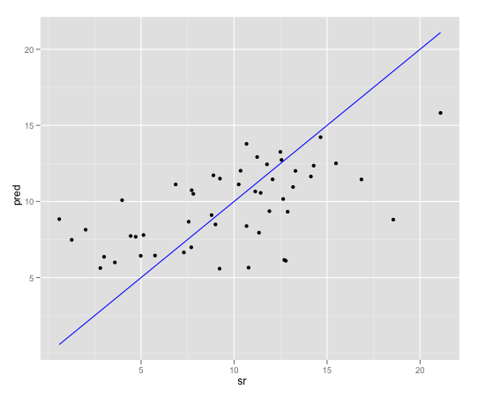
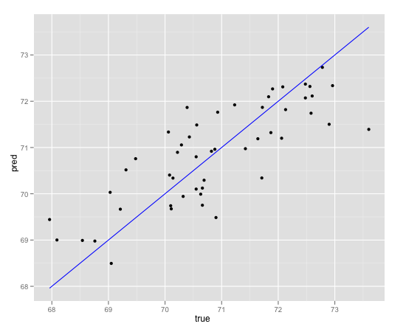
Diagnostics (Continued)
overpredicts for low true values, underpredicts at higher values. Improve the model.
Plot it!
Prediction vs. true outcome
Look for:
Systematic over/under prediction
Non-consistent variance
The data cloud should be symmetric about the line of true prediction
Glaring outliers
You will see other diagnostic plots in the lab
Not quite consistent variance, but much better.
Notes:
Even if everything before looks fairly reasonable, it's still a good idea to plot the prediction vs. true outcome. R base package comes with standard graphs but developing plots as the one shown here (generated with ggplot2) is more intuitive for stakeholders to understand.
What you have to look for is that the model does not systematically over predict or under predict in certain ranges. We want the variance to be Consistent (the cloud around the line to be symmetrical). These plots also identify the obvious outliers in the data.
The two graphs show examples of a model in which we over predict for low true values and under predict at higher values. (Graph on the top of the slide).
The graph at the bottom shows an improvement of the model (selecting the correct range, eliminating correlated variables etc). Even in this plot we still do not see a consistent variance but the model fit seems to be better here.

Slide 38
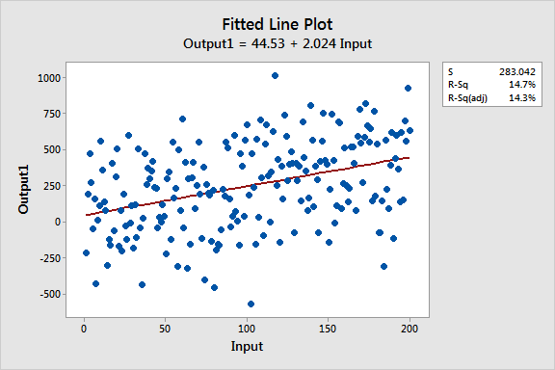
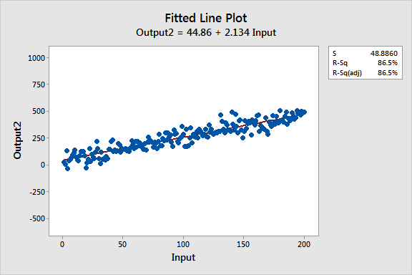
Comparing R-Squared
Regression equations: Output = 44 + 2 * Input
Input is significant with P < 0.001 for both models
R-Sq = 14.7%
R-Sq = 86.5%

Slide 39
Coefficients, P-Value, and R-Squared
The coefficients estimate the trends while R-squared represents the scatter around the regression line.
The interpretations of the significant variables are the same for both high and low R-squared models.
Low R-squared values are problematic when you need precise predictions.

Slide 40
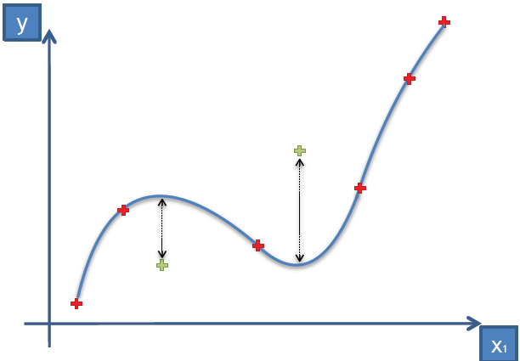
Overfitting Problem
The fitting curve fits the data perfectly well,
but if we look at new observations, we can get large errors

Slide 41
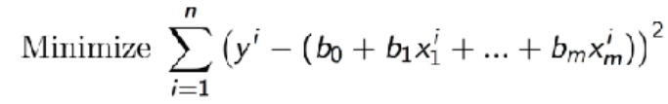
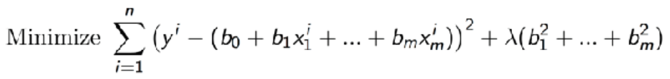
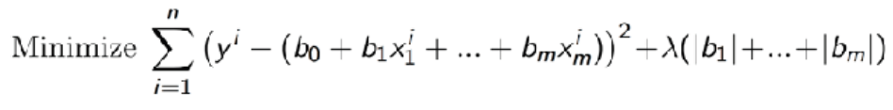
Examples of Regularization (Ridge – Lasso – Elastic Net)
Least Square Err Func

Slide 42
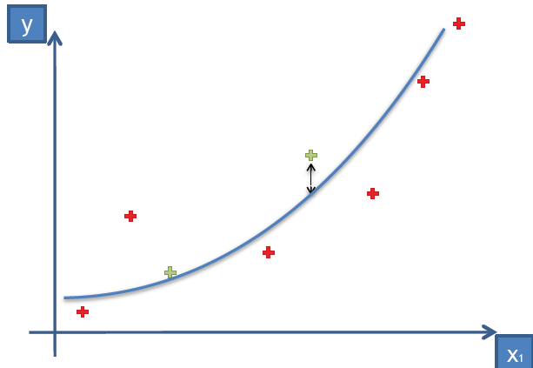
Regularization Reduces Overfitting

Slide 43
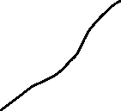
Linear Regression - Reasons to Choose (+) and Cautions (-)
Reasons to Choose (+) | Cautions (-)
Concise representation (the coefficients) | Does not handle missing values well
Robust to redundant variables, correlated variables Lose some explanatory value | Assumes that each variable affects the outcome linearly and additively Variable transformations and modeling variable interactions can alleviate this A good idea to take the log of monetary amounts or any variable with a wide dynamic range
Explanatory value Relative impact of each variable on the outcome | Can't handle variables that affect the outcome in a discontinuous way Step functions
Easy to score data | Doesn't work well with discrete drivers that have a lot of distinct values For example, ZIP code
Discontinuous Data
Notes:
Linear regressions have the explanatory values and we can easily determine how the variables affect the outcome. It is robust to redundant variables and correlated variables. The prediction is not impacted but we lose some explanatory value with the fitted model. Linear regression provides the concise representation of the outcome with the coefficients and it is easy to score the data with this model.
Cautions (-) are that Linear regression does not handle the missing values well. It assumes that each variable affects the outcome linearly and additively. So if we have some variables that affect the outcome non-linearly and the relationships are not actually additive the model does not fit well. Variable transformations and modeling variable interactions can address this to some extent.
It is recommended to take the log of monetary amounts or any variable with a wide dynamic range. It cannot handle variables that affect the outcome in a discontinuous way. We discussed the issue of infinite magnitude coefficients earlier where the prediction is inconsistent in ranges. Also when you have discrete drivers with a large number of distinct values the model becomes complex and computationally inefficient.

